Slide 1
Java Script
Script is a line of code that can be execute on client side(browser) and server side(web server).
JavaScript is a scripting language
JavaScript is a most recommended client side scripting language.
JavaScript is used for Client side and Server side.
JavaScript helps to Develop build more functional and interactive websites.
Common uses of JavaScript :
Alert messages
Popup windows
Dynamic dropdown menus
Form validation
Displaying date/time

Slide 2
Java Script
Java script code is executed with in the browser[all the browsers are preconfigured with JavaScript]
JavaScript is a browser independent and open source scripting language
JavaScript is a Case Sensitive.
JavaScript is a interpreted not compiled.
JavaScript is Object based.
JavaScript code is easily embedded with HTML

Slide 3
Java Script
Syntax:
<script type="text/ JavaScript">
document.write("JavaScript is not Java");
</script>
The <script> tags tell the browser to expect a script in between them. We specify the language using the type attribute. The most popular scripting language on the web is JavaScript.
Where to put your scripts?
You can place your scripts in any of the following locations:
Between the HTML document's head tags.
Within the HTML document's body (i.e. between the body tags).
In an external file [.js file](and link to it from your HTML document).

Slide 4
JavaScript variables
JavaScript variable can be declared with var data type.
Variable names must begin with a letter, under-score or $,
Ex: var a=10
var x,y
x=“abc”
y=30
var b
document.write(b) //undefined
Variables declaration is not compulsory in JavaScript. (If you don't declare a variable explicitly, JavaScript will declare it implicitly for you.)

Slide 5
Java Script Operators
Arithmetic Operators | Assignment Operators | Comparison Operators | Logical/ Boolean Operators
+ | = | == | &&
- | += | ===(is identical) is equal to and is of the same type | ||
* | -= | != | !
/ | *= | !==(is not identical) | true
% | /= | >,< | false
++,-- | %= | >=,<= | +(string concatination)

Slide 6
Java Script
Conditional Statements:
If
If else
If else ladder
Nested if
switch
Iterative Statements:
While
Do while
For and Foreach
Note: Syntax of Conditional and Iterative statements is similar to c,c++

Slide 7
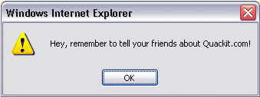
Java Script Popups
Types of Popups
They can also referred to as "dialog boxes", "JavaScript dialogs", "popup dialog" etc.
JavaScript has three different types of popup box
Alert
Displays a message to the user.
Alert(“Message”)

Slide 8
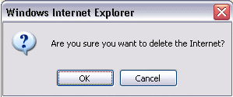
Java Script Popups
Confirm
Asks the user to confirm something.
When u click ok it returns ture,click cancel returns false.
Confirm(“Message”)

Slide 9
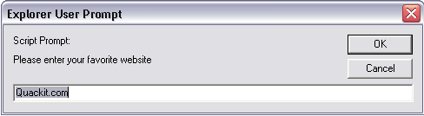
Java Script Popups
Prompt
Prompts the user for information.
When u click ok it returns Textbox value, click cancel return null value.
prompt("Message", "Default response");

Slide 10
Java Script Functions
Writing a function in JavaScript
function function-name()
{
}
function function-name(parameter-list)
{
}
function function-name(parameter-list)
{
return value
}
Callingfunction:
function_name(),
funcation_name(value)

Slide 11
Java Script Comments
//Java script single line comment
/* java script
multi-line comment */
<!-- alert(“Hello java script”) -->
<NOSCRIPT>
Java script is not supported
</NOSCRIPT>

Slide 12
DataTypes
Data types supported by Java Script are
Numeric – integer and floating point numbers
String-
alert(“Hello”) ;or
alert(‘Hello’) ;
Boolean- true, false
Conversion functions:
parseInt() and parseFloat()
To convert string to int and float respectively

Slide 13
External Script
Scripts can also be written in a separate file called JavaScript file.
JavaScript file is a collection of JavaScript Functions.
Extension of JavaScript file is .js
JavaScript file can be referenced in a HTML file.
<HTML>
<HEAD>
<SCRIPT type="text/javaScript” SRC=“jsfile.js”>
</SCRIPT>
</HEAD>
</HTML>

